Slide 1



Customer Segmentation Analysis Presentation
Author: Poojitha Gollapudi
Created with Pi

Slide 2

CONTENTS
1. Introduction
2. Data Preparation
3. Customer Profiling
4. Clustering Analysis
5. Visualization
6. Conclusion

Slide 3

1. Introduction
This project represents a comprehensive data science initiative developed for Flipkart's customer analytics framework. The primary objective is to implement an advanced customer segmentation methodology using RFM (Recency, Frequency, Monetary) analysis combined with machine learning clustering techniques. The solution enables data-driven customer insights, personalized marketing strategies, and optimized business decision-making through systematic analysis of purchasing behavior patterns and customer value assessment across the e-commerce platform

Slide 4

2. Data Preparation
Libraries Import
The project leverages a robust suite of Python libraries specifically selected for data manipulation, statistical analysis, and machine learning implementation. Pandas provides comprehensive data structures for efficient data handling and transformation, while NumPy delivers advanced mathematical computing capabilities for numerical operations. Matplotlib and Seaborn enable sophisticated data visualization for business intelligence and insight generation. Scikit-learn forms the core machine learning framework, facilitating customer segmentation through clustering algorithms and data preprocessing techniques essential for accurate analytical outcomes.

Slide 5

Load Dataset
The analytical process commences with the systematic loading of transactional customer data from structured CSV files containing comprehensive purchase history records. The dataset encompasses critical business dimensions including customer identifiers, product information, transaction categories, purchase amounts, and temporal purchase dates. Initial data exploration involves examining dataset structure, assessing data quality, and understanding variable distributions to establish a foundation for subsequent analytical processing and ensure data integrity throughout the analytical pipeline.

Slide 6

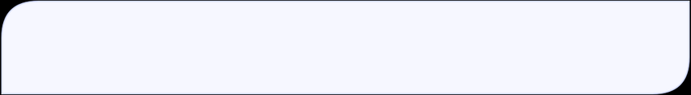
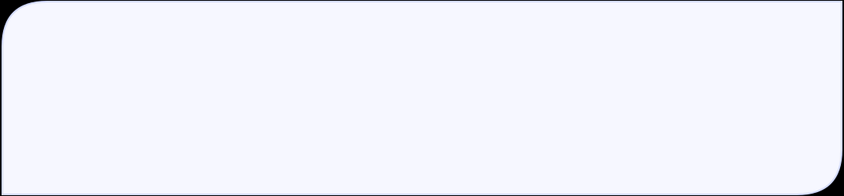
Data Cleaning and Transformation
Convert PurchaseDate to datetime format
The PurchaseDate column is converted to datetime type for further analysis.
Checking for missing values
The code checks how many missing values are present in each column.
Handle missing values
• Drop rows where CustomerID or ProductID is missing (critical).
• Fill PurchaseAmount missing values with 0.
• Fill Category missing values with 'Unknown'.
A rigorous data cleaning protocol is implemented to address data quality issues and ensure analytical reliability. This involves systematic identification and treatment of missing values through strategic imputation and removal protocols

Slide 7

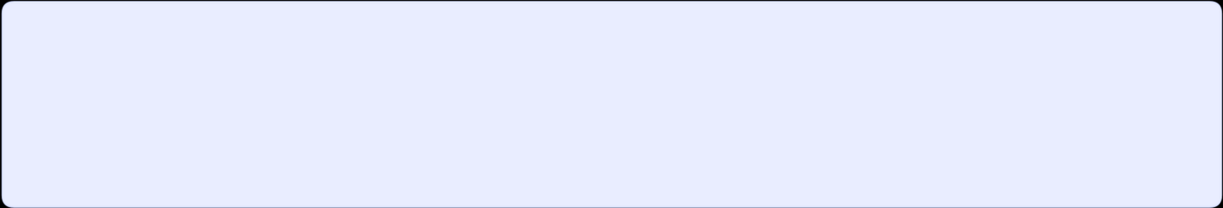
Data Type Correction
Ensure correct data types for analysis
• Convert CustomerID, ProductID, and Category to string types.
• Convert PurchaseAmount to float type.
• Correct PurchaseDate format.

Slide 8

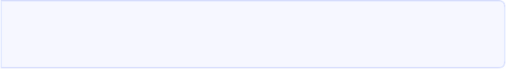
3. Customer Profiling
Profiling Metrics
Total spend
Comprehensive data type correction ensures optimal memory utilization and computational efficiency throughout the analytical workflow. Customer and product identifiers are converted to string format to preserve leading zeros and categorical integrity. Numerical purchase amounts are standardized as float data types to maintain precision in monetary calculations. Date-time conversion facilitates temporal analysis and enables accurate time-based feature engineering. This systematic type standardization ensures compatibility with machine learning algorithms and prevents computational errors during model training and evaluation
The total amount spent by each customer.
Purchase frequency
The number of purchases made by each customer.
Average purchase amount
The mean value of purchases for each customer.
Recency
The number of days since the last purchase.
Preferred category
Identified based on the most frequent purchases.

Slide 9

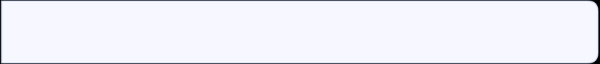
Merging Profiles
Merge the data to form a comprehensive customer profile.
The profile merging process consolidates individually calculated RFM metrics into a unified customer profile dataset through systematic database joining operations. This integration combines recency measurements, frequency counts, and monetary values for each unique customer identifier. The merged profile dataset serves as the foundational input for subsequent machine learning algorithms, providing a comprehensive view of customer behavior patterns. Additional demographic and preference attributes are incorporated to enhance segmentation accuracy and enable more personalized recommendation generation.

Slide 10

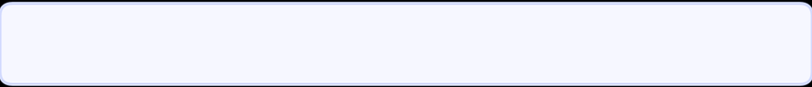
4. Clustering Analysis
Data Scaling
Standardize features to have a mean of 0 and standard deviation of 1.
Data scaling represents a critical preprocessing step that standardizes RFM metrics to ensure equitable contribution during clustering analysis. StandardScaler implementation transforms all features to a common scale with zero mean and unit variance, preventing feature dominance based on measurement units. This normalization process ensures that recency, frequency, and monetary metrics contribute equally to distance calculations in the clustering algorithm. Proper scaling enhances segmentation quality, improves algorithm convergence, and enables the identification of meaningful customer groups based on balanced behavioral characteristics.

Slide 11
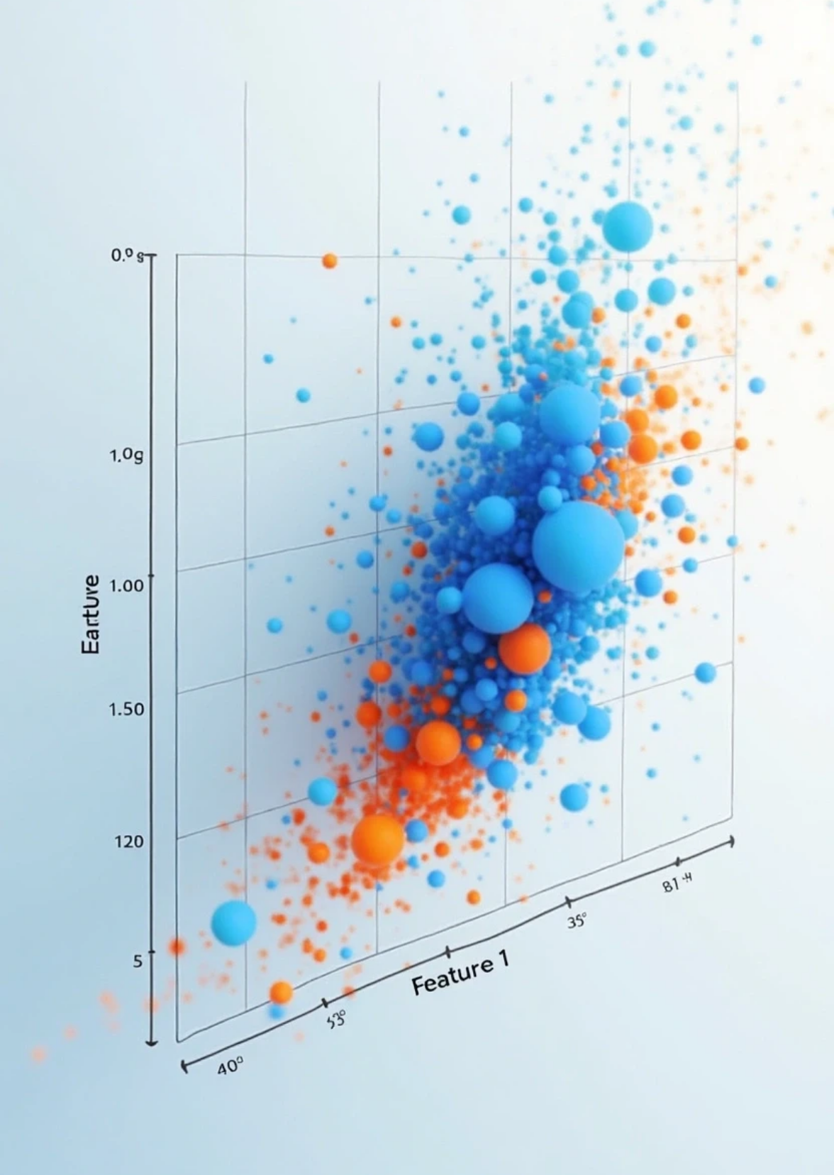
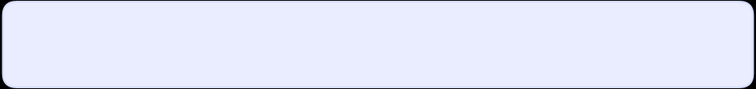
K-Means Clustering
Apply K-Means clustering with a specified number of clusters.
K-Means Clustering Framework:
The project employs K-Means clustering, an unsupervised machine learning algorithm, to segment customers into distinct groups based on their RFM (Recency, Frequency, Monetary) characteristics. This partitioning method groups customers with similar purchasing behaviors, enabling targeted marketing strategies and personalized business approaches.

Slide 12
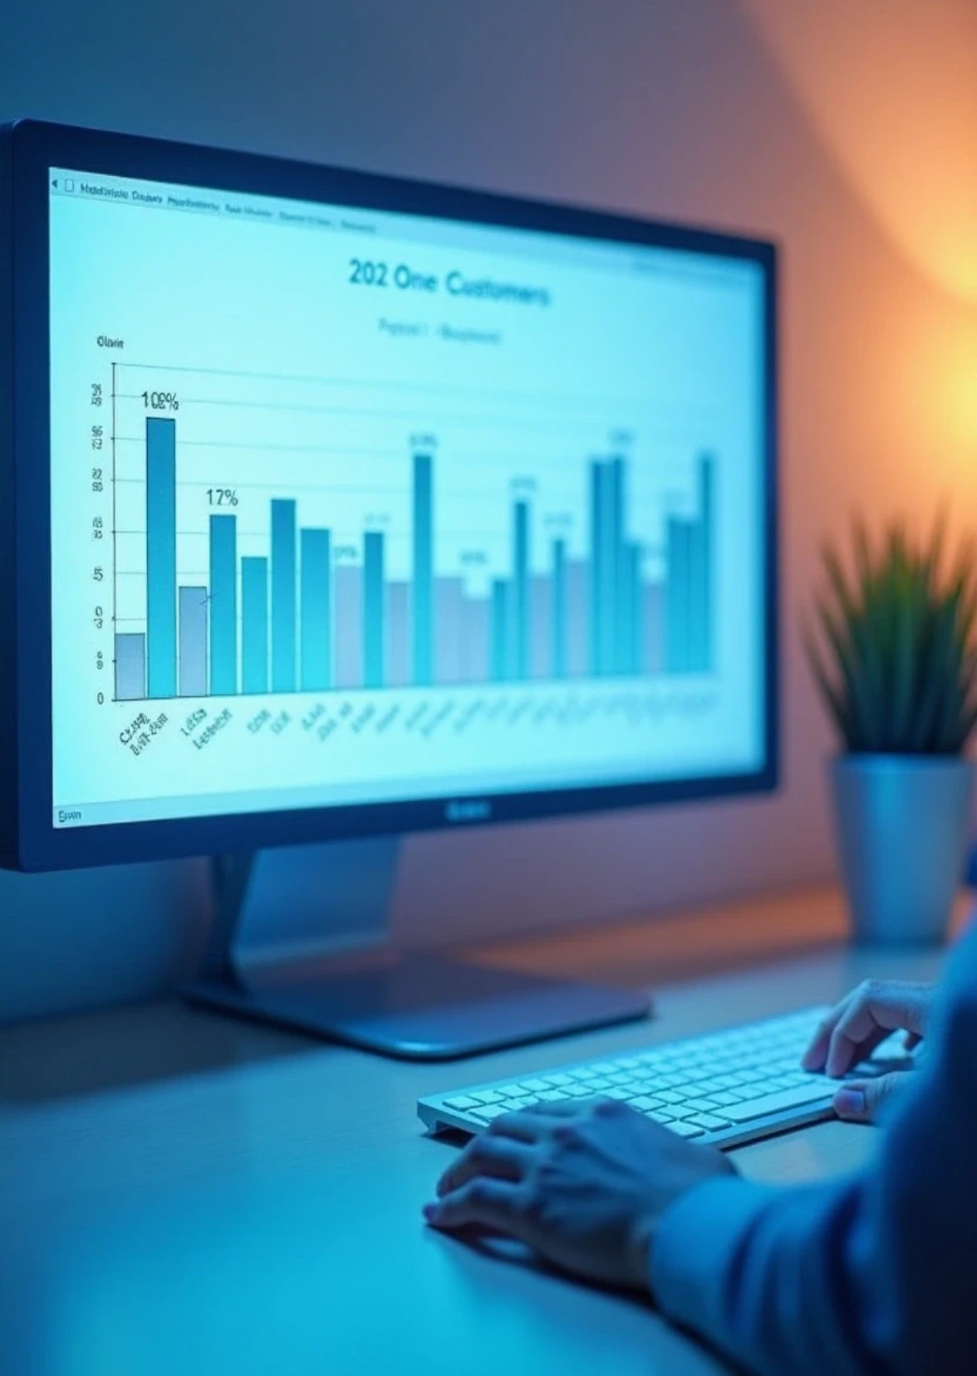
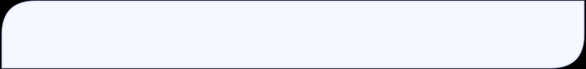
5. Visualization
Cluster Distribution
A count plot of customer distribution across clusters.
Cluster Distribution Overview:
The visualization presents the quantitative distribution of customers across the three identified segments, providing a clear overview of customer base composition and segment proportionality. This distribution analysis forms the foundation for strategic resource allocation and targeted marketing initiatives.

Slide 13
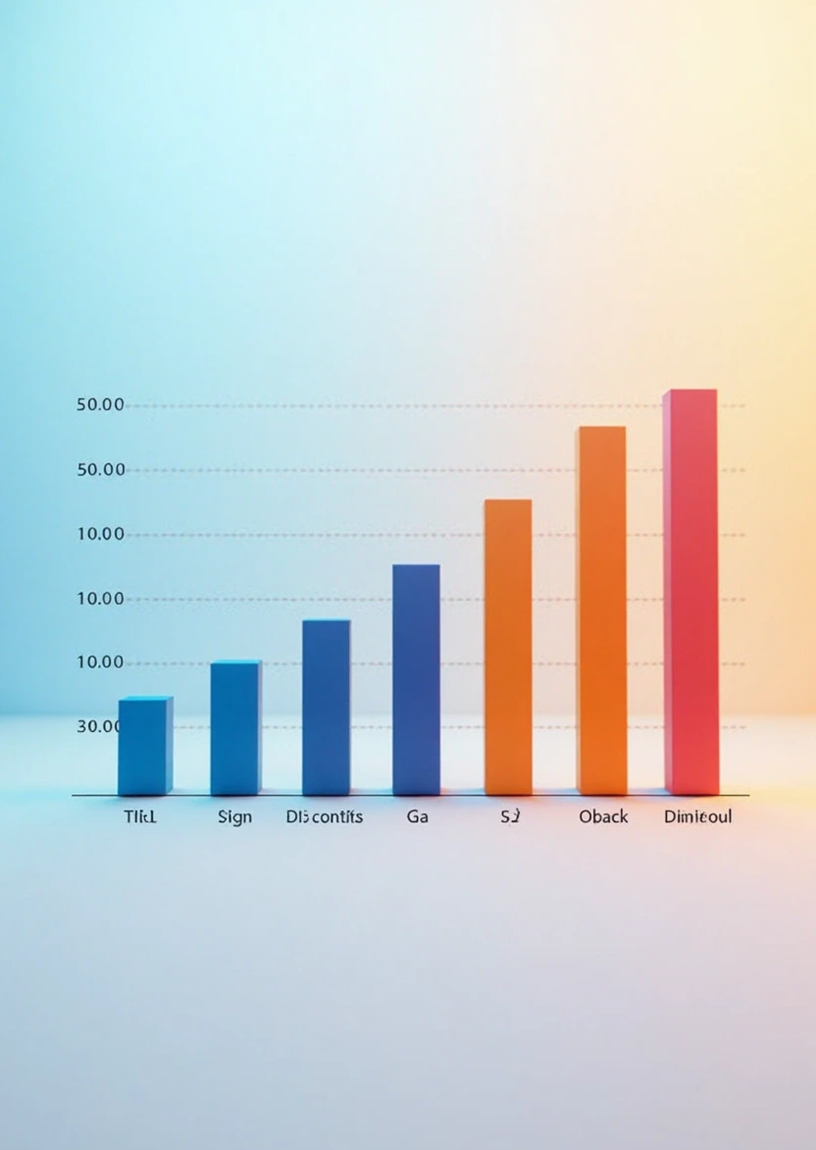
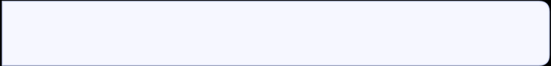
Average Spend per Cluster
A bar plot depicting average spend per cluster.
The analysis of average spending per cluster reveals three distinct customer segments: High-Value customers demonstrate premium spending and drive the majority of revenue, Moderate-Value customers show balanced spending with strong growth potential, and Low-Value customers exhibit minimal transactional value. Critically, the data validates the Pareto principle with approximately 20% of customers generating 60% of total revenue, providing clear strategic direction for focused retention programs targeting high-value segments while maintaining cost-efficient acquisition strategies for broader customer base development.

Slide 14

6. Conclusion
The analysis provides a robust framework for understanding customer behavior through segmentation, which can lead to more targeted marketing strategies.

Slide 15

Thank You

